Slide 1
Chapter 3 Pipelining and Parallel Processing (Tạo đường ống và xử lý song song)
ĐHBK Tp HCM
BMĐT
GV: Hồ Trung Mỹ
TLTK:
Các slide từ sách của Prof. Parhi
Slide của Prof. Viktor Öwall

Slide 2
Outline
Introduction
Pipelining of FIR Digital Filters
Parallel Processing
Pipelining and Parallel Processing for Low Power
Pipelining for Lower Power
Parallel Processing for Lower Power
Combining Pipelining and Parallel Processing for Lower Power

Slide 3
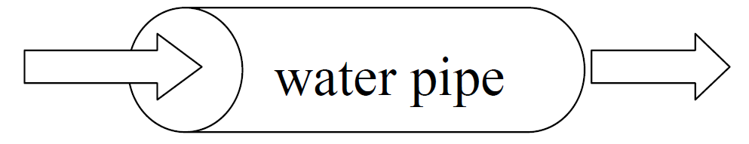
3.1 Introduction
Pipelining
Comes from the idea of a water pipe: continue sending water without waiting the water in the pipe to be out
Splits the logic path by introducing pipiline registers
Leads to a reduction of the critical path but introduce latency
Either increases the clock speed (or sampling speed) or reduces the power consumption at same speed in a DSP system
Parallel Processing
Multiple outputs are computed in parallel in a clock period
The effective sampling speed is increased by the level of parallelism
Can also be used to reduce the power consumption

Slide 4
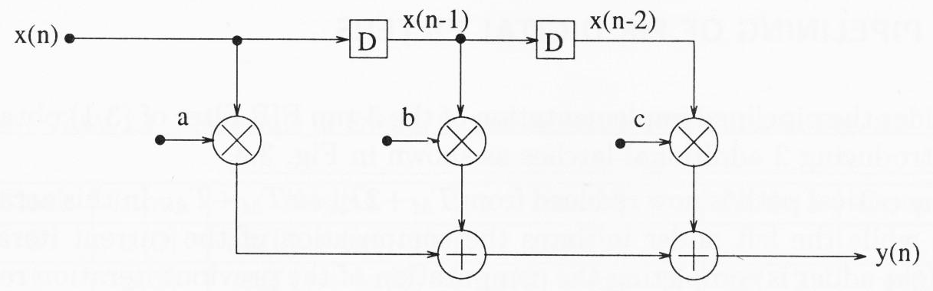

Example 1: A 3-tap FIR Filter
Consider a 3-tap FIR filter: y(n) = ax(n) + bx(n-1) + cx(n-2)
The critical path (or the minimum time required for processing a new
sample) is limited by 1 multiply and 2 add times. Thus, the “sample period” (or the “sample frequency” ) is given by:
If some real-time application requires a faster input rate (sample rate), then this direct-form structure cannot be used! In this case, the critical path can be reduced by either pipelining or parallel processing.

Slide 5
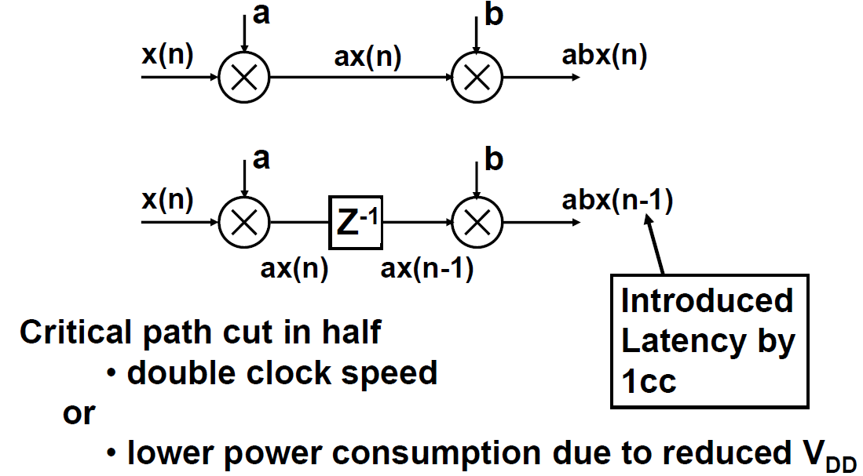
Pipelining
Introduce pipelining latches along the datapath

Slide 6
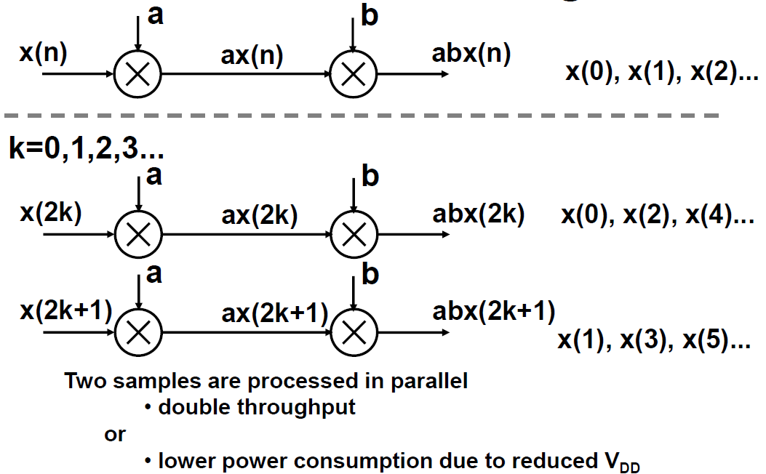
Parallel processing
Duplicate the hardware

Slide 7
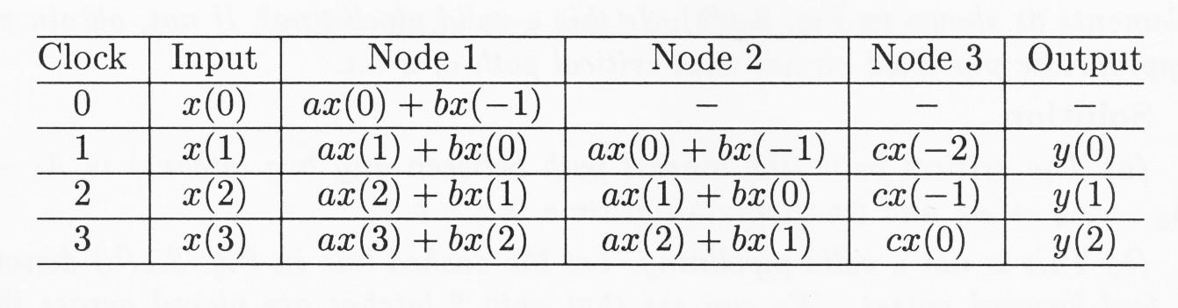
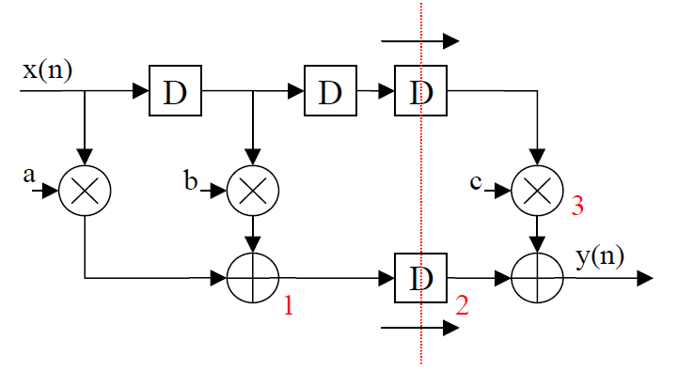
3.2 Pipelining of FIR Digital Filters
The pipelined implementation: By introducing 2 additional latches in Example 1, T_{critical}: T_{M}+2T_{A} → T_{M}+T_{A}.
Note: You can see that, at any time, 2 consecutive outputs are computed in an interleaved manner.

Slide 8
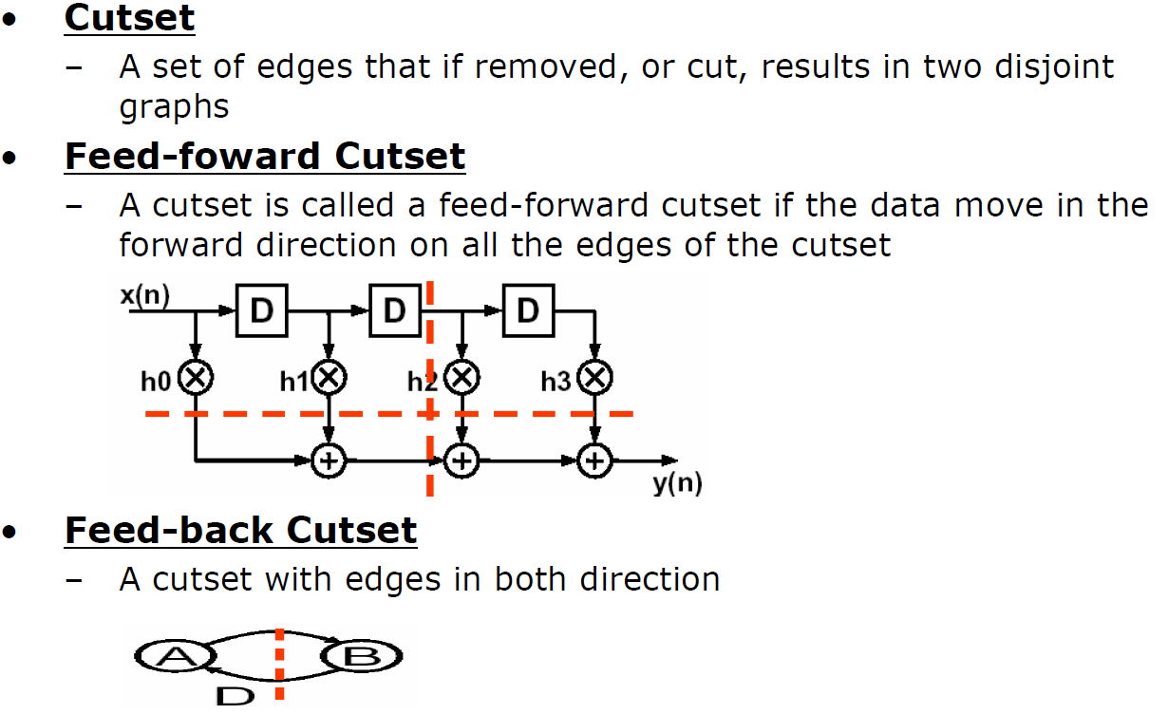
Pipelining: Definitions

Slide 9
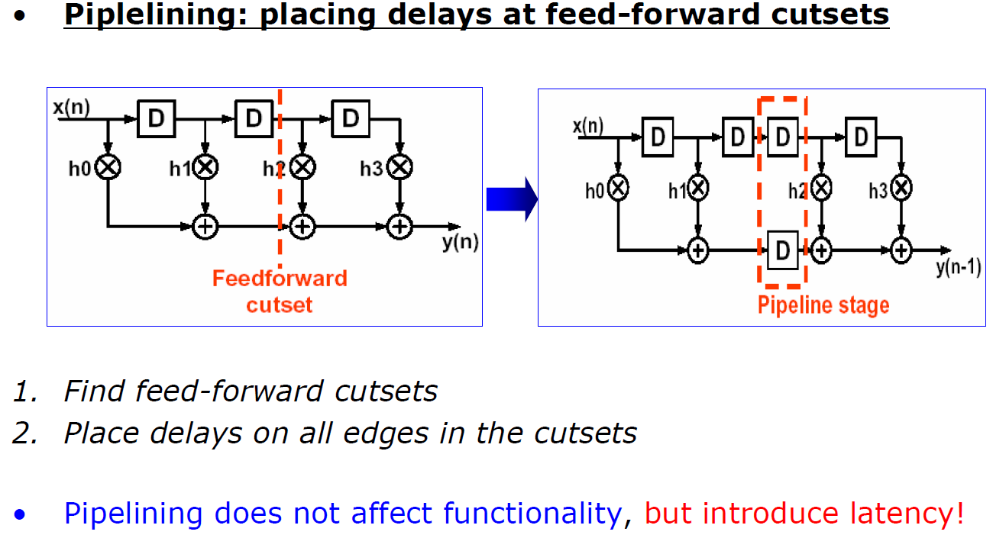
Pipelining: How to ?

Slide 10
Pipelining
Drawbacks
Increase number of delay elements (registers/latches) in the critical path
In an M-level pipelined system, the number of delay elements in any path from input to output is (M-1) greater than that in the same path in the original sequential circuit
Increase latency
Clock period limitation: critical path may be between
An input and a latch
A latch and an output
Two Latches
An input and an output
Pipelining latches can only be placed across any feed-forward cutset of the graph

Slide 11
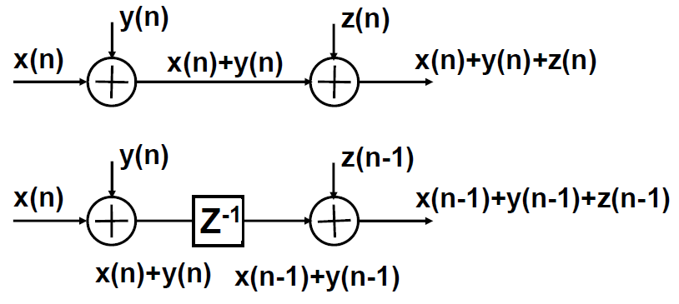
What if…
We said before that the critical path was cut in half. Under what assumption?
For example: What if the adders are ripple-carry?

Slide 12
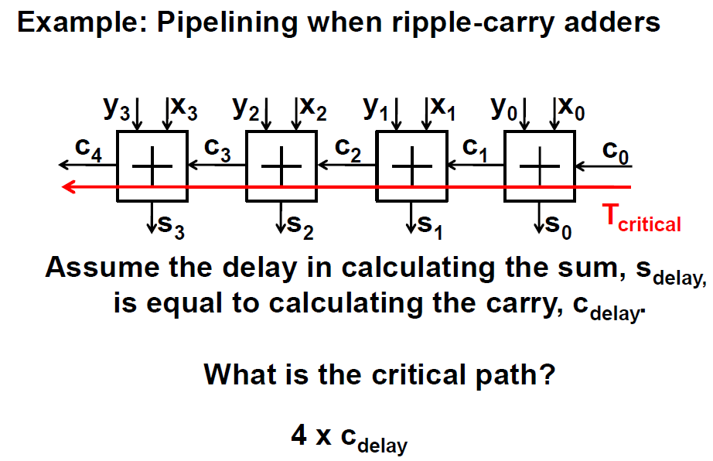

Slide 13
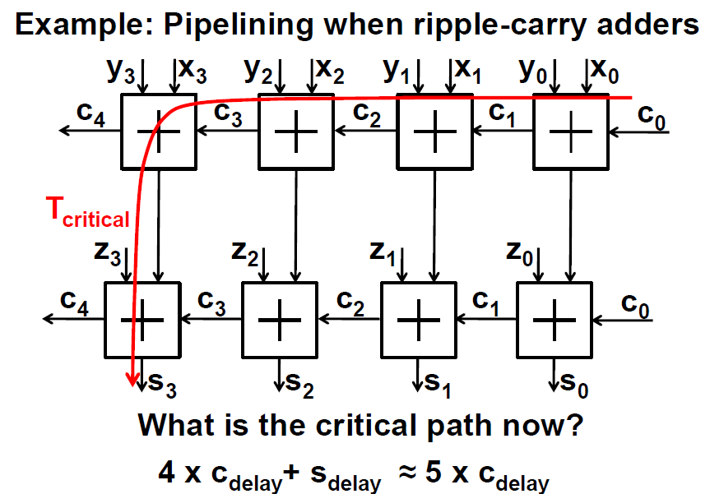

Slide 14
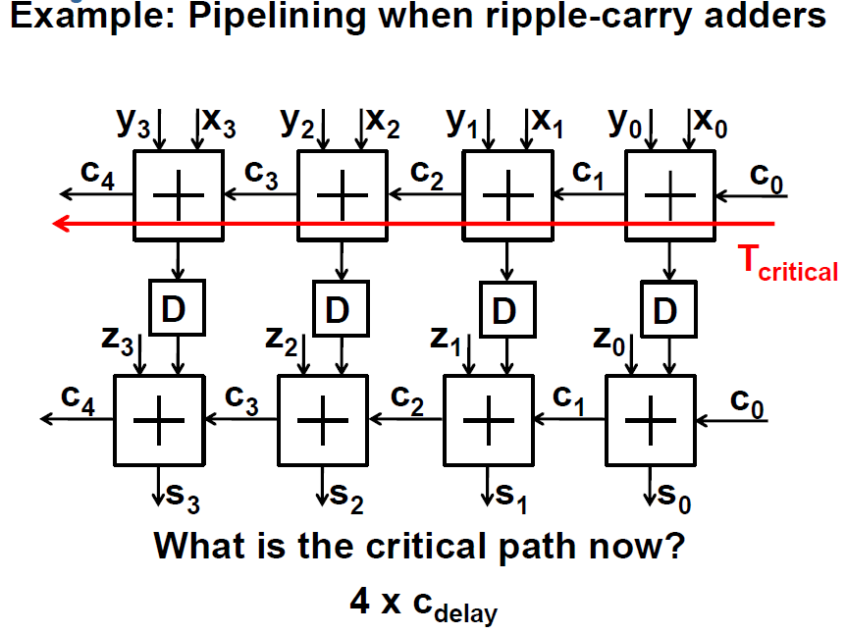
Not much gained!

Slide 15
Conclusion
The result depends on the structure of the used blocks, e.g. type of adder (ripple-carry, carry save, carry look-ahead,...)
We have to understand how the blocks work and if the critical paths are independent or if there is a relationship.

Slide 16
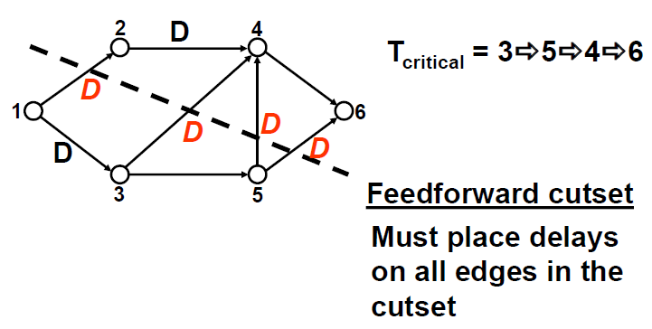
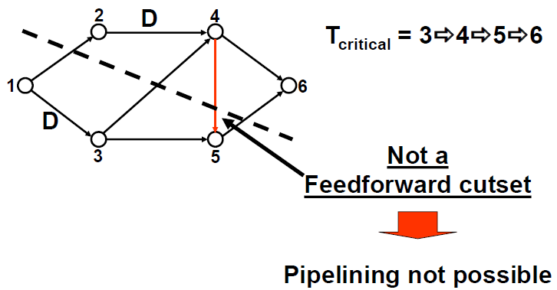
Feedforward Cutsets

Slide 17
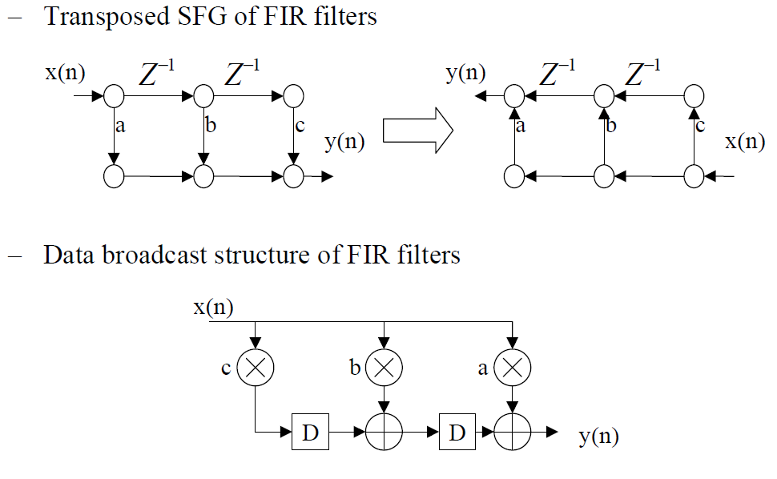
Transposition Theorem
Reversing the direction of all edges in a given SFG and interchanging the input and output ports preserve the functionality of the system.
Transposed SFG and Data-broadcast structure of FIR filters:

Slide 18
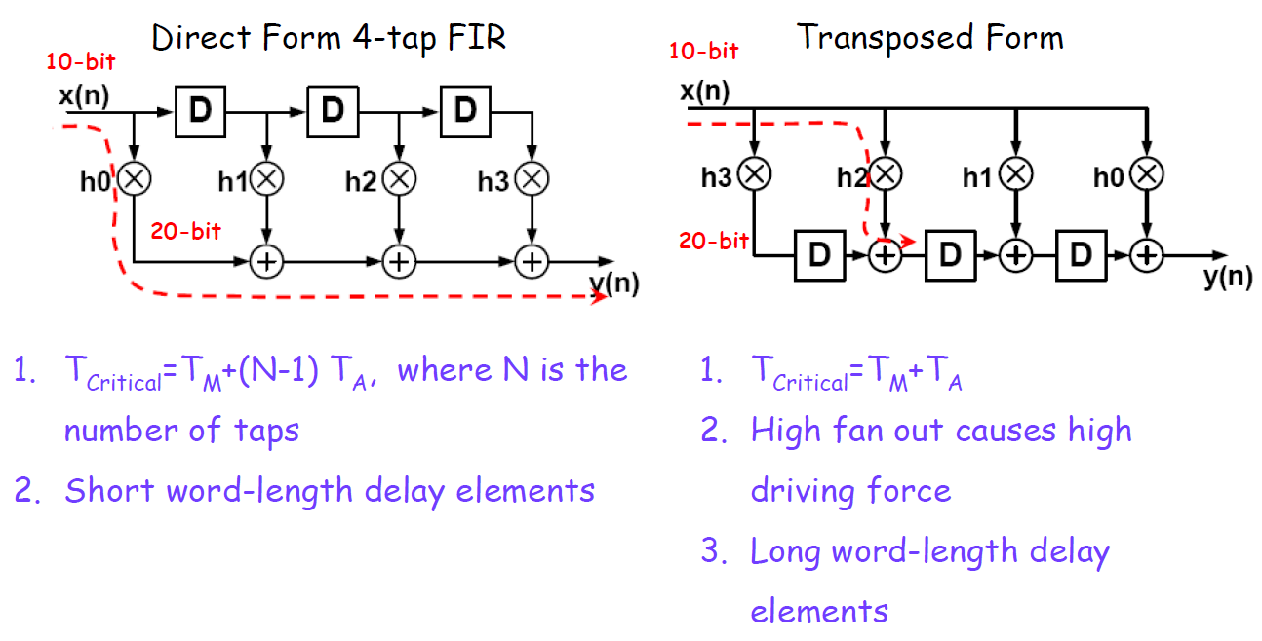
Transposed Form
Critical path: the path with the longest computation time among all paths without delay elements

Slide 19
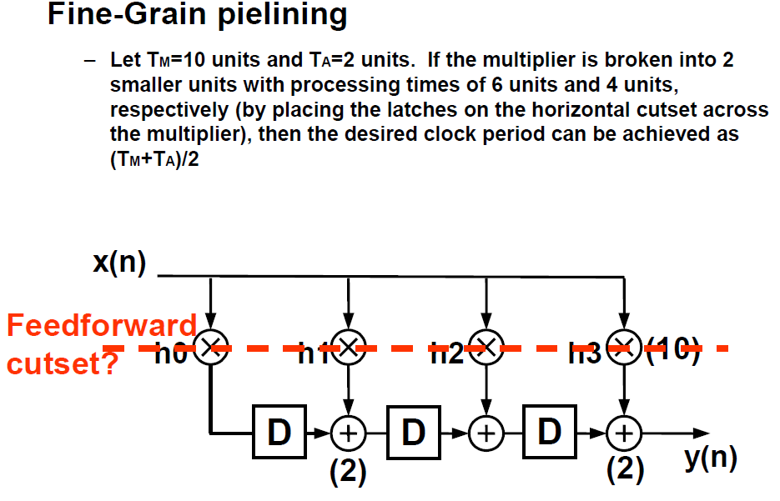

Slide 20
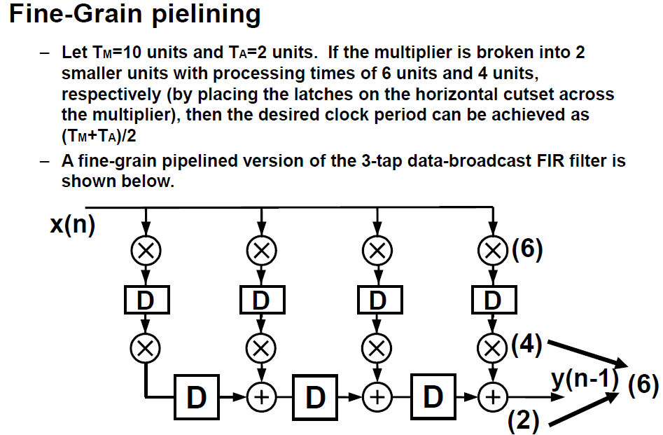

Slide 21
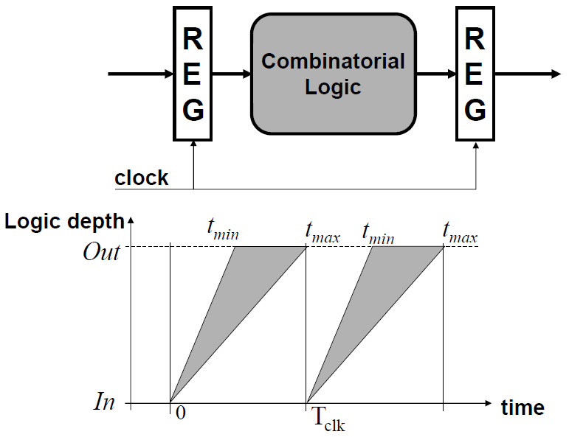
Synchronous Pipelining

Slide 22
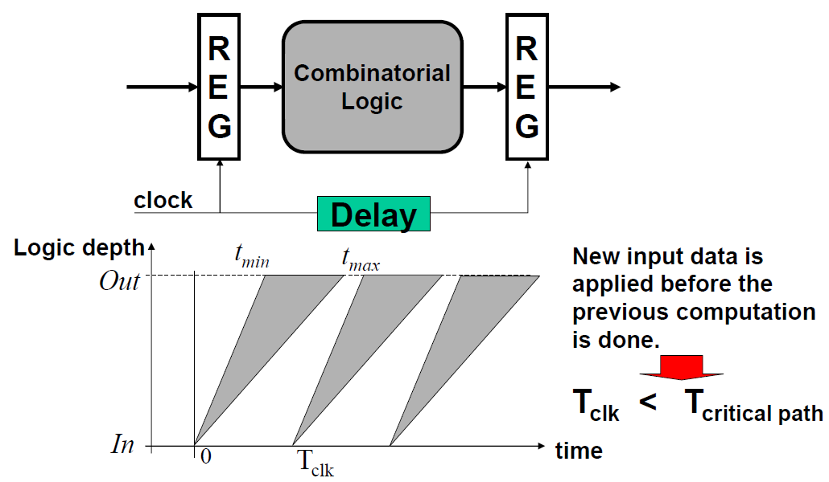
Wave Pipelining

Slide 23
Wave pipelining: Pros and cons?
Pros:
Shorter Tclk
Cons:
extensive simulation
tedious design
hard to verify
lack of tools

Slide 24
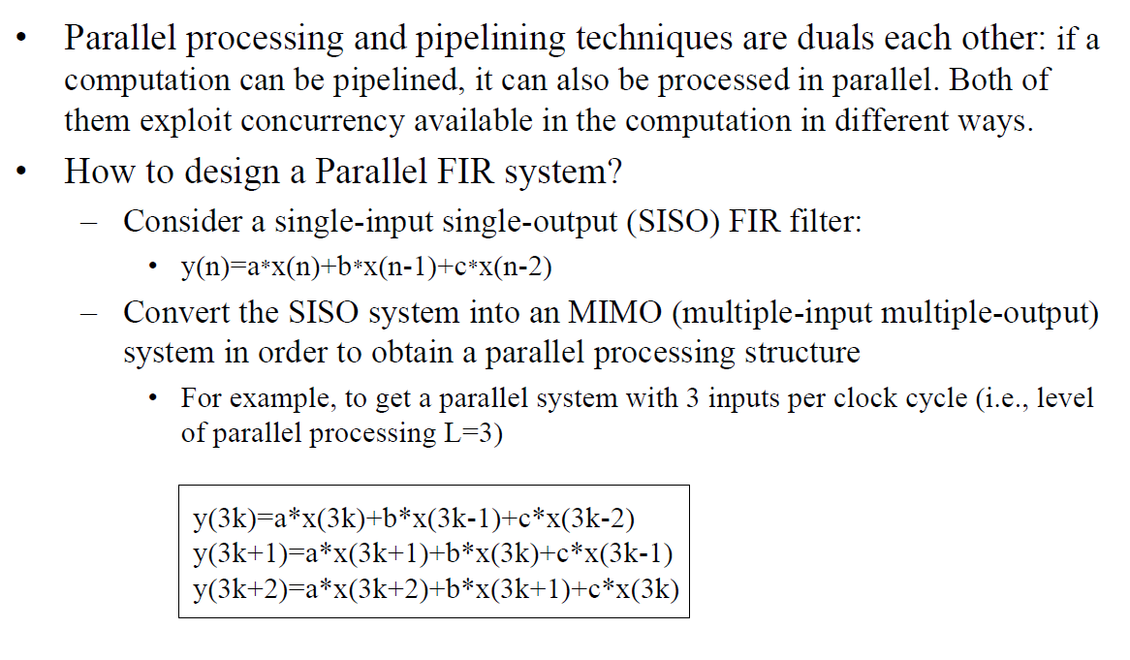
3.3 Parallel Processing

Slide 25
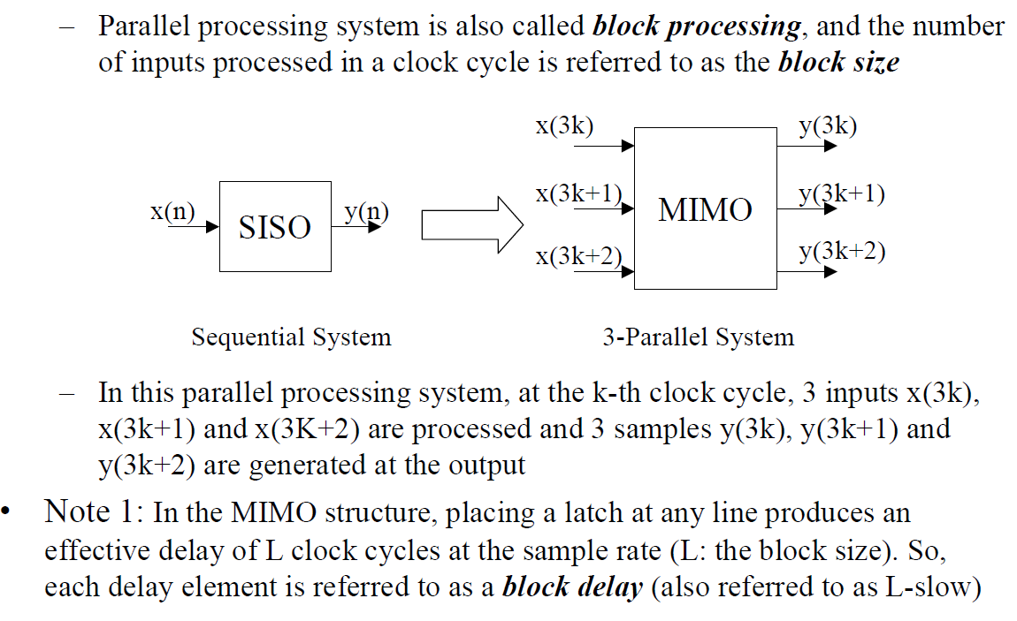
Parallel Processing (cont’d)

Slide 26
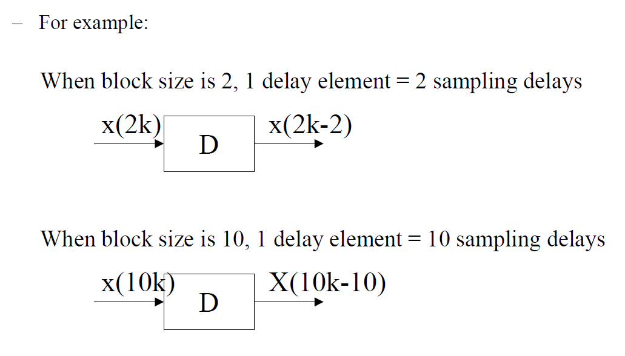
Parallel Processing (cont’d)
= x(2(k-1))
= x(10(k-1))

Slide 27
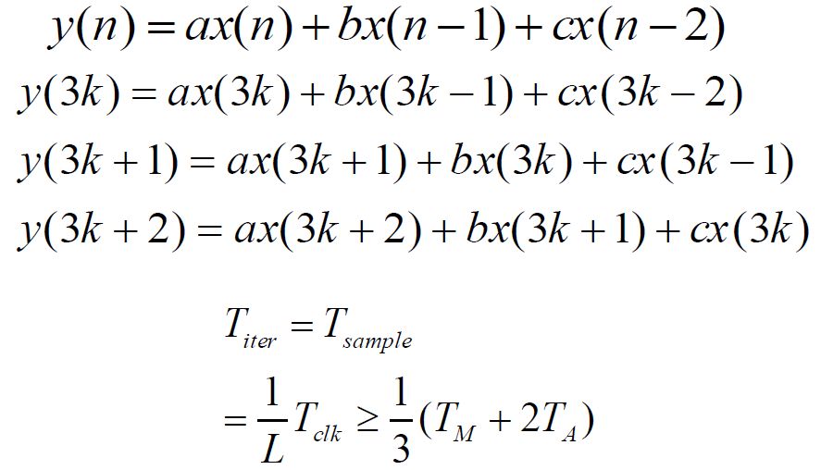
Parallel Processing of 3-Tap FIR Filter

Slide 28
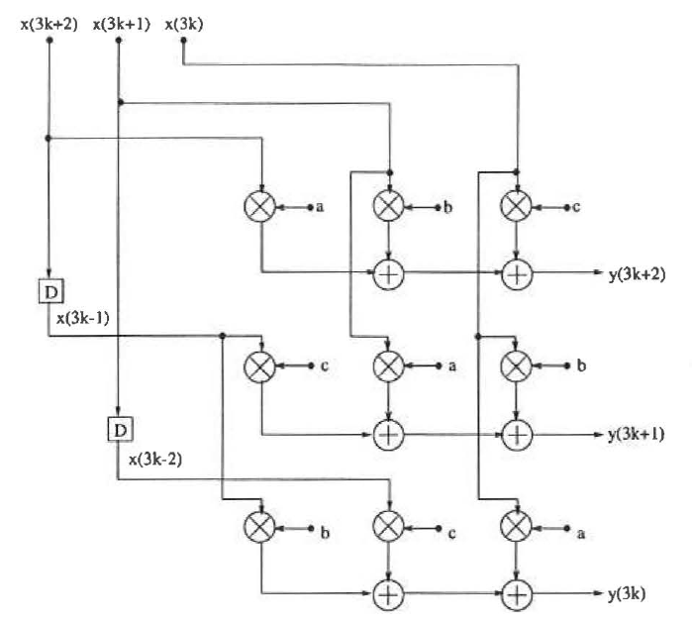
Parallel processing architecture for a 3-tap FIR filter with block size 3

Slide 29
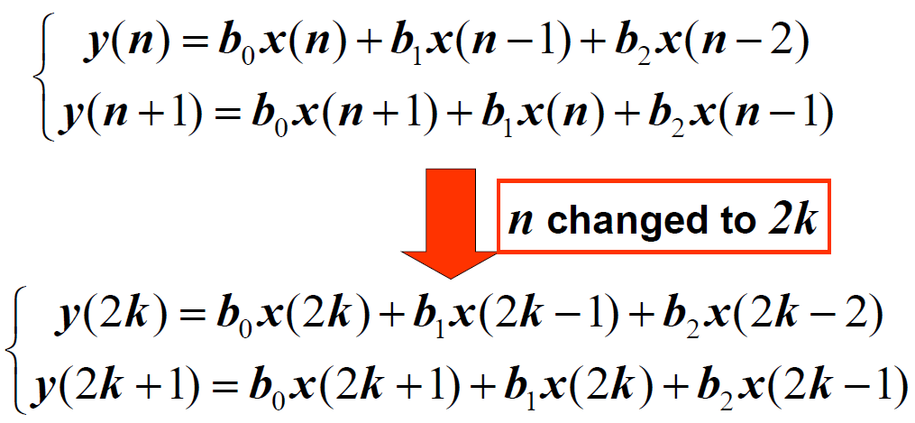
Parallel 3-Tap FIR Filter

Slide 30
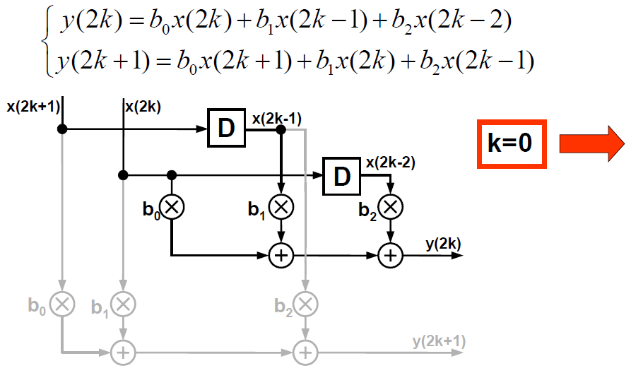
Parallel 3-Tap FIR Filter (2/9)

Slide 31
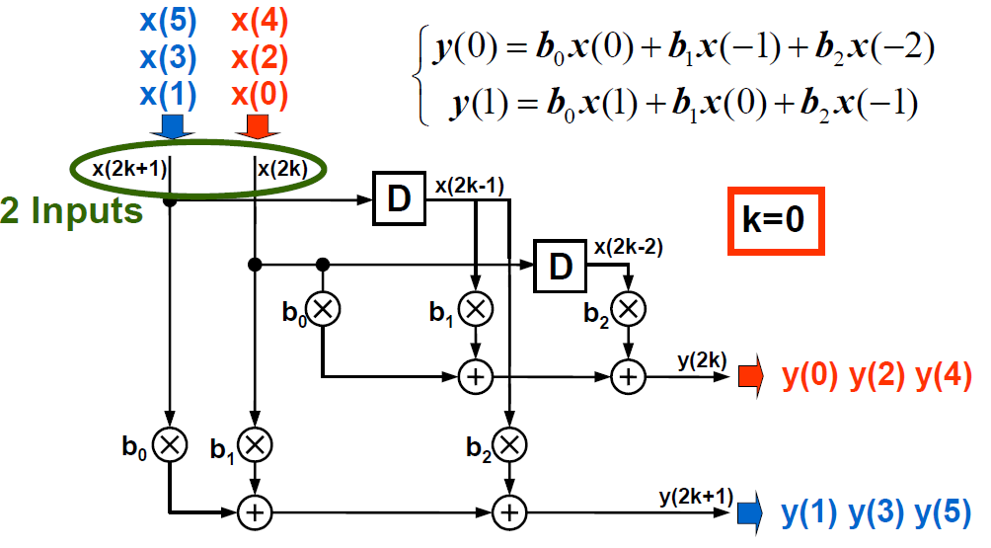
Parallel 3-Tap FIR Filter (3/9)

Slide 32
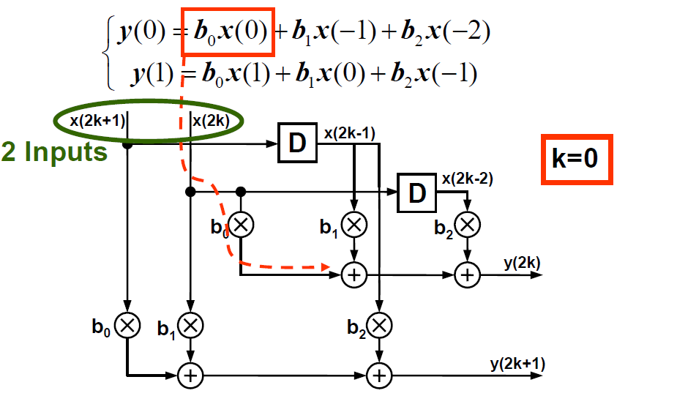
Parallel 3-Tap FIR Filter (4/9)

Slide 33
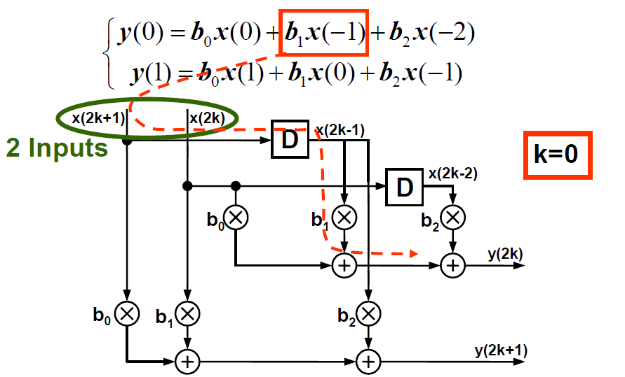
Parallel 3-Tap FIR Filter (5/9)

Slide 34
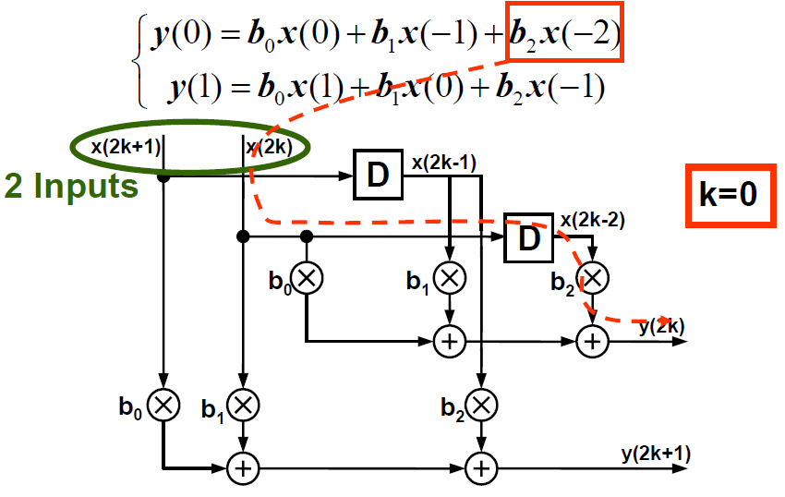
Parallel 3-Tap FIR Filter (6/9)

Slide 35
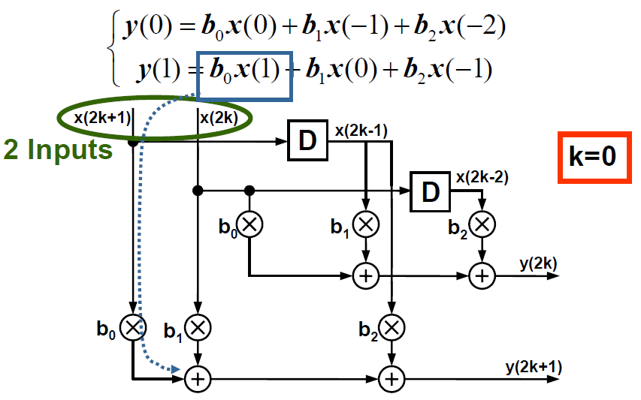
Parallel 3-Tap FIR Filter (7/9)

Slide 36
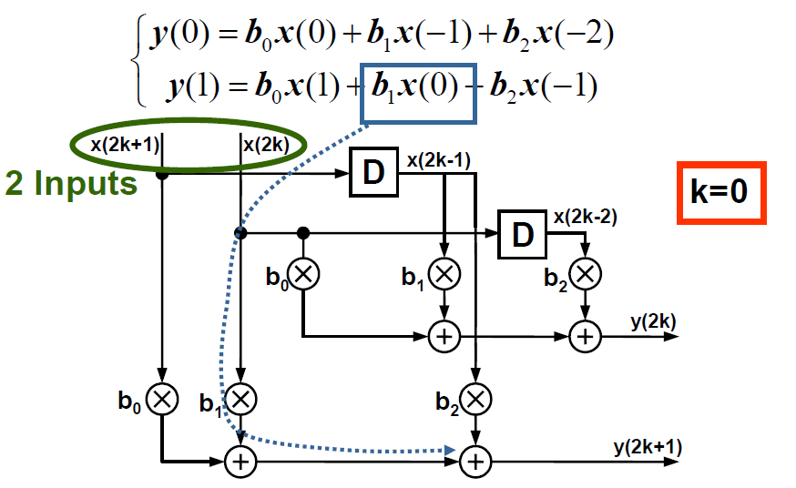
Parallel 3-Tap FIR Filter (8/9)

Slide 37
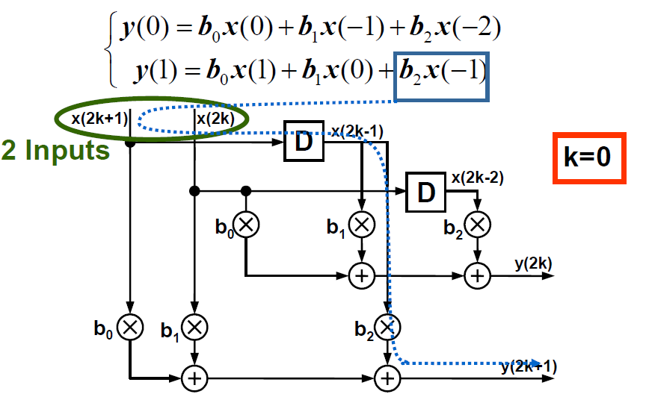
Parallel 3-Tap FIR Filter (9/9)

Slide 38
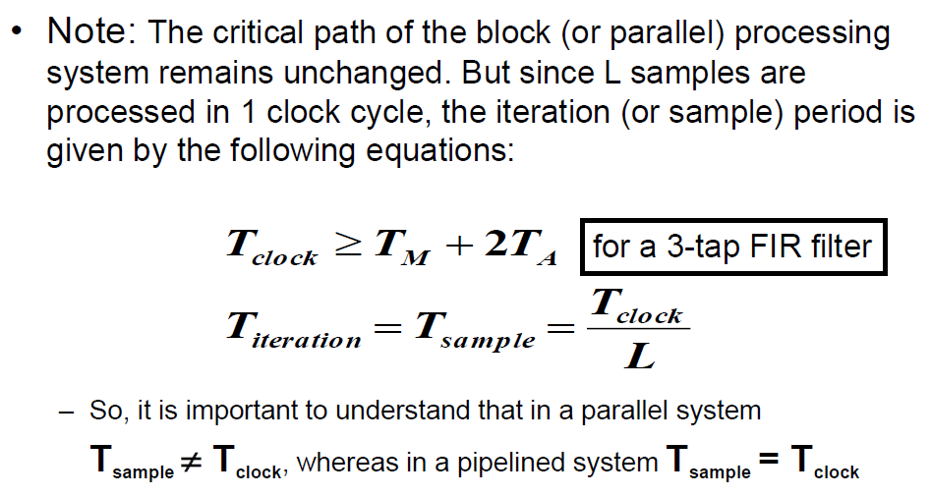
Parallel Processing (cont’d)

Slide 39
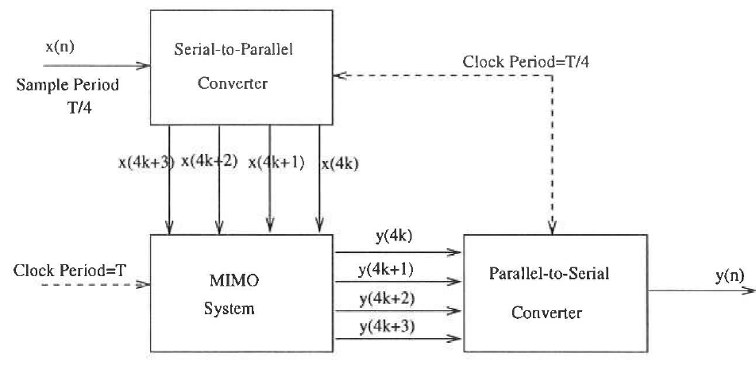
Complete parallel processing system with block size 4

Slide 40
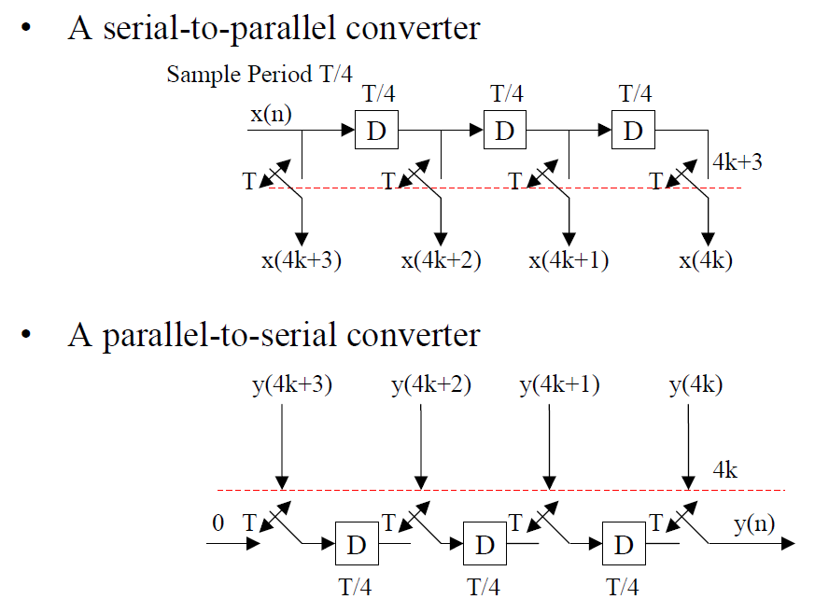
Complete parallel processing system with block size 4

Slide 41
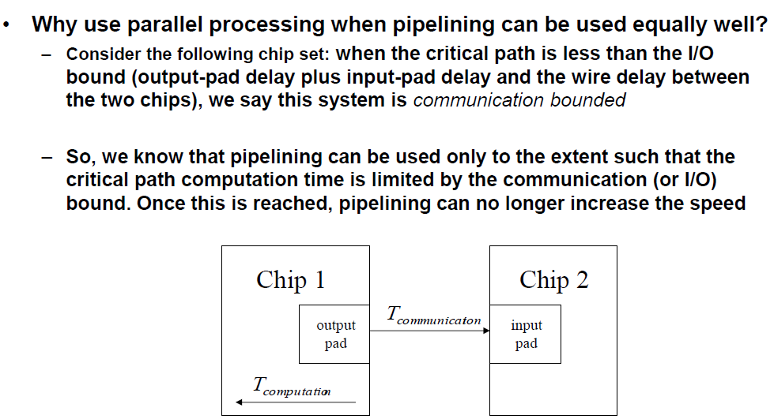
Why Parallel Processing?

Slide 42
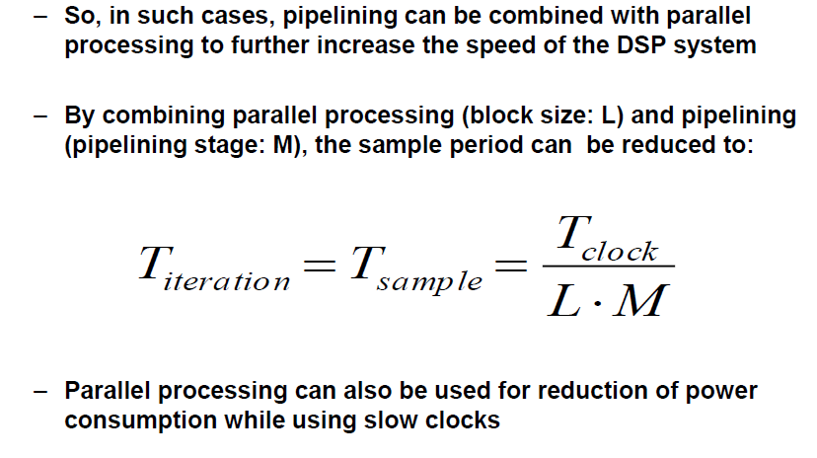
Why Parallel Processing?

Slide 43
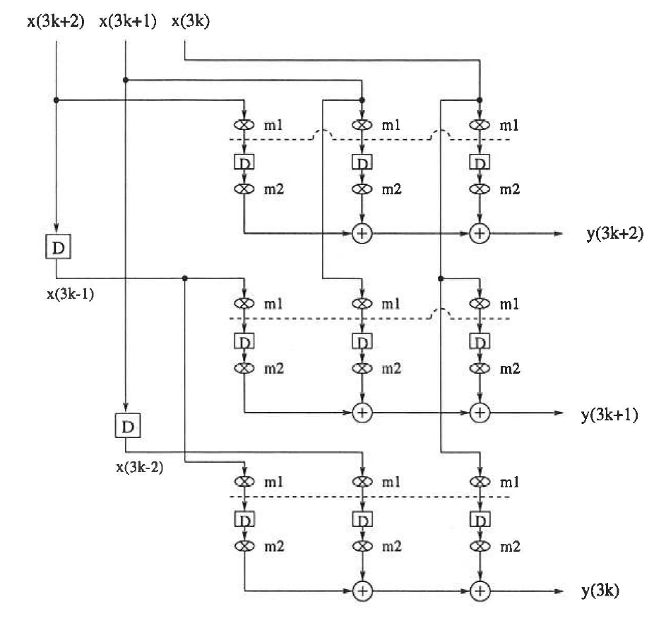
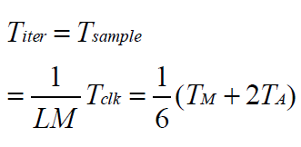
Example: Combined fine-grain pipelining and parallel processing for 3-tap FIR filter

Slide 44
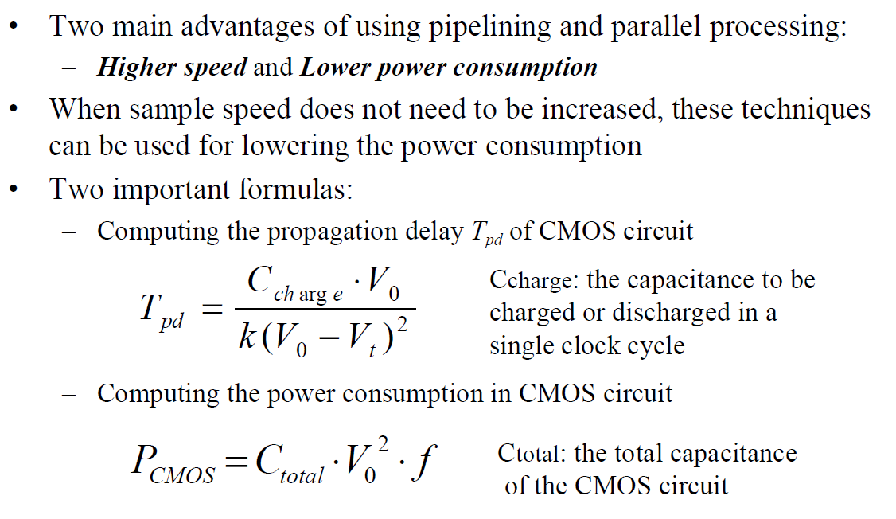
3.4 Pipelining and Parallel Processing for Low Power

Slide 45
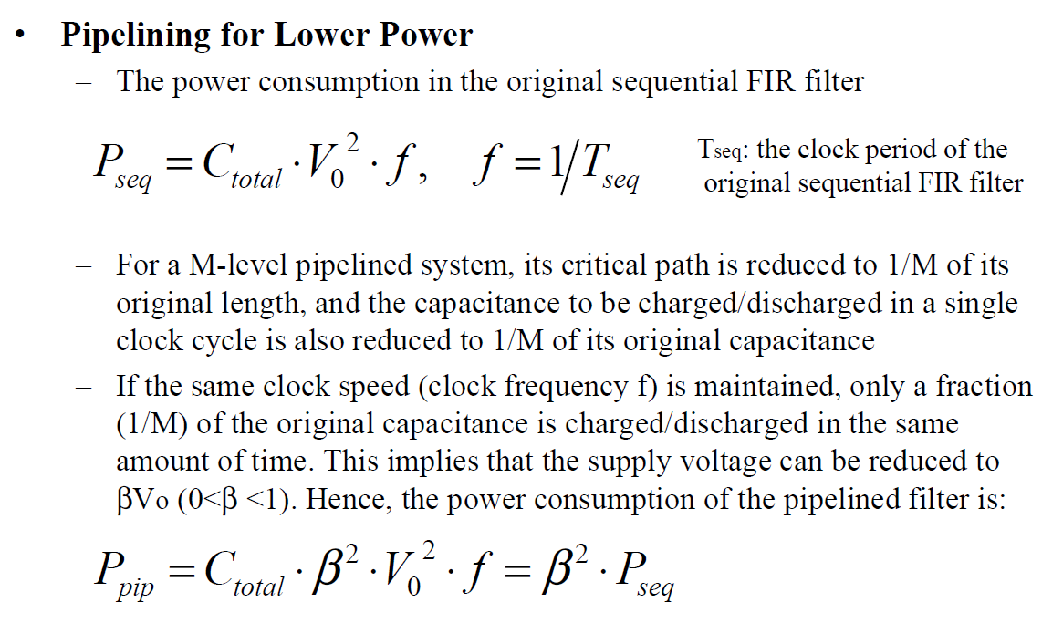
Pipelining and Parallel Processing for Low Power

Slide 46
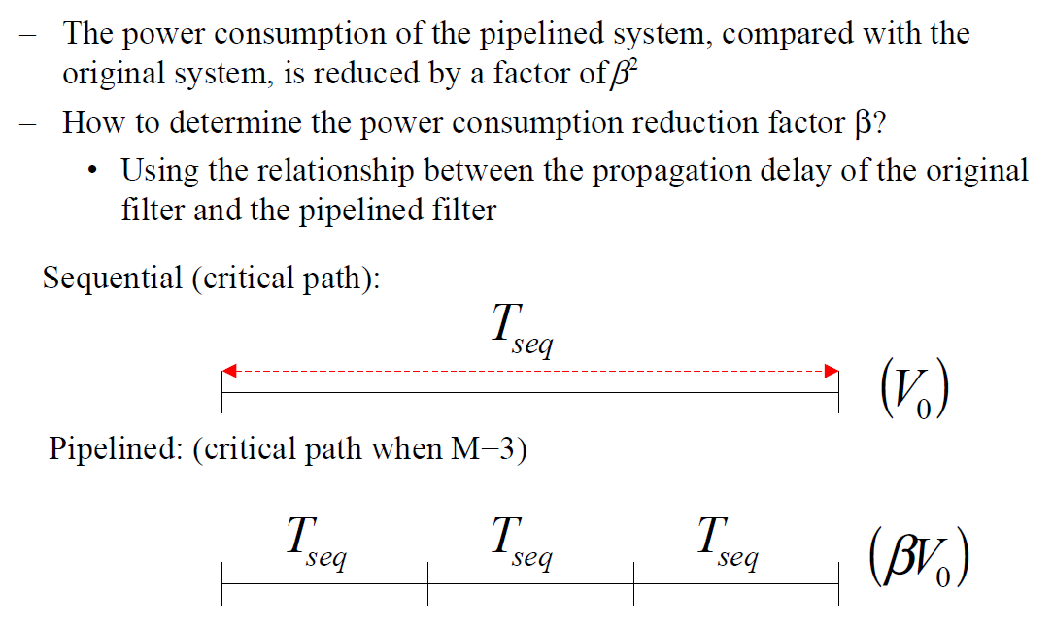
Pipelining and Parallel Processing for Low Power

Slide 47
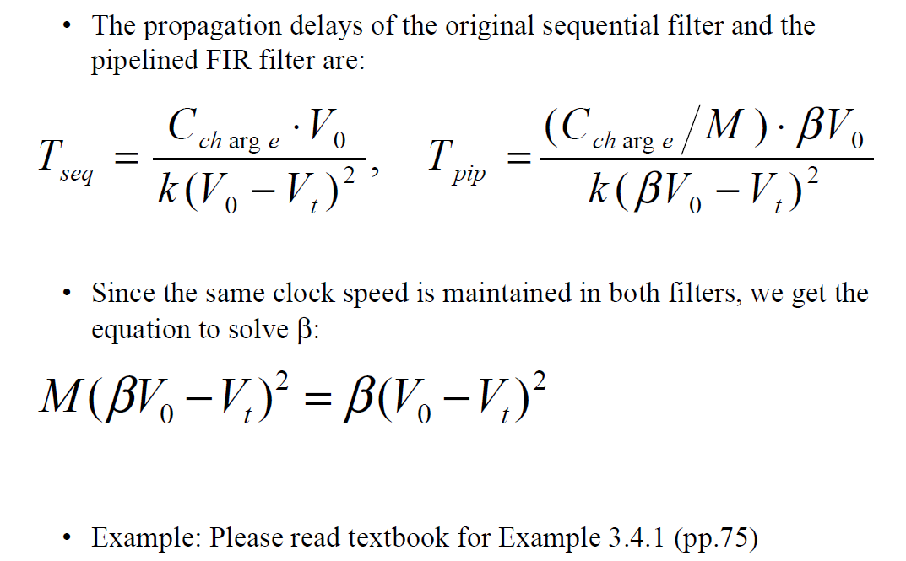
Pipelining and Parallel Processing for Low Power

Slide 48
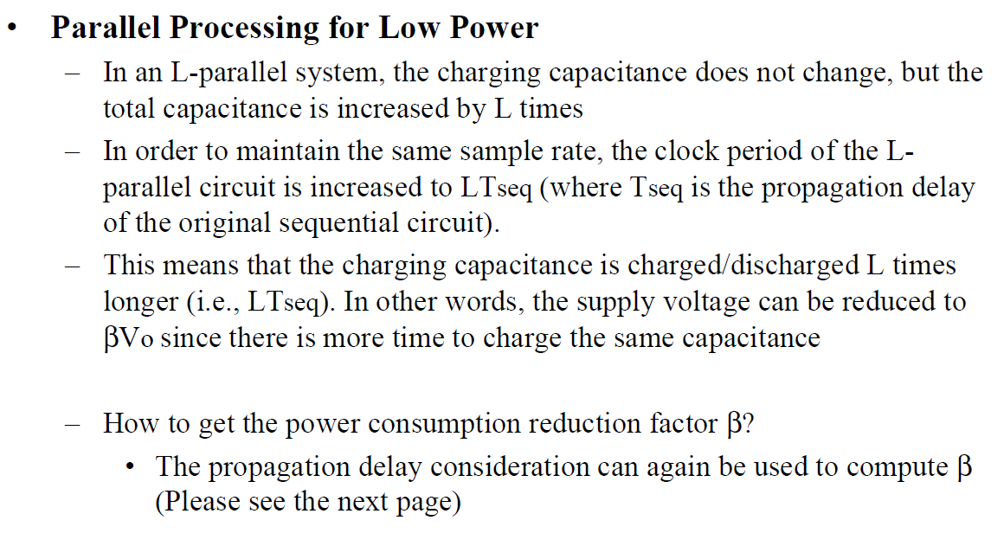
Pipelining and Parallel Processing for Low Power

Slide 49
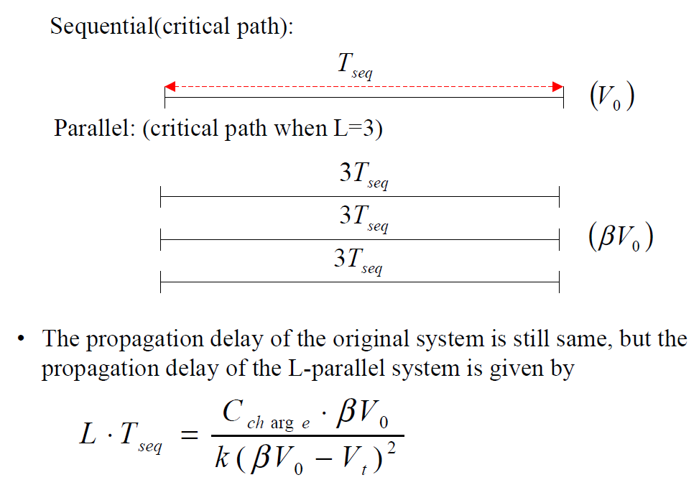
Pipelining and Parallel Processing for Low Power

Slide 50
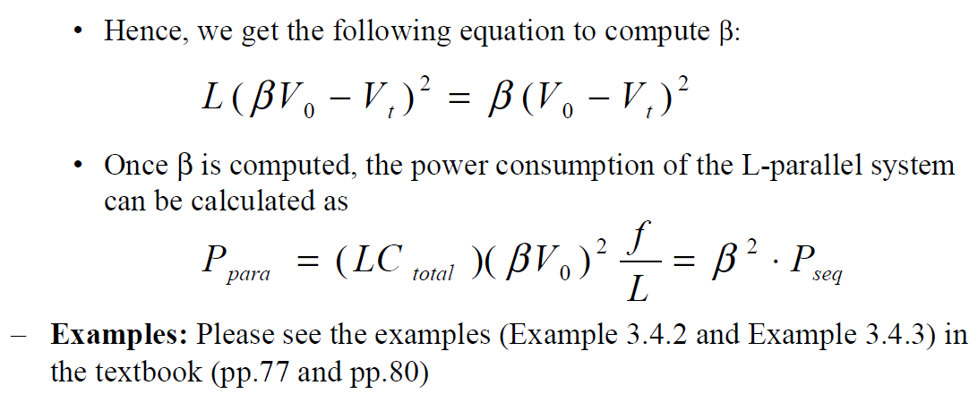
Pipelining and Parallel Processing for Low Power

Slide 51
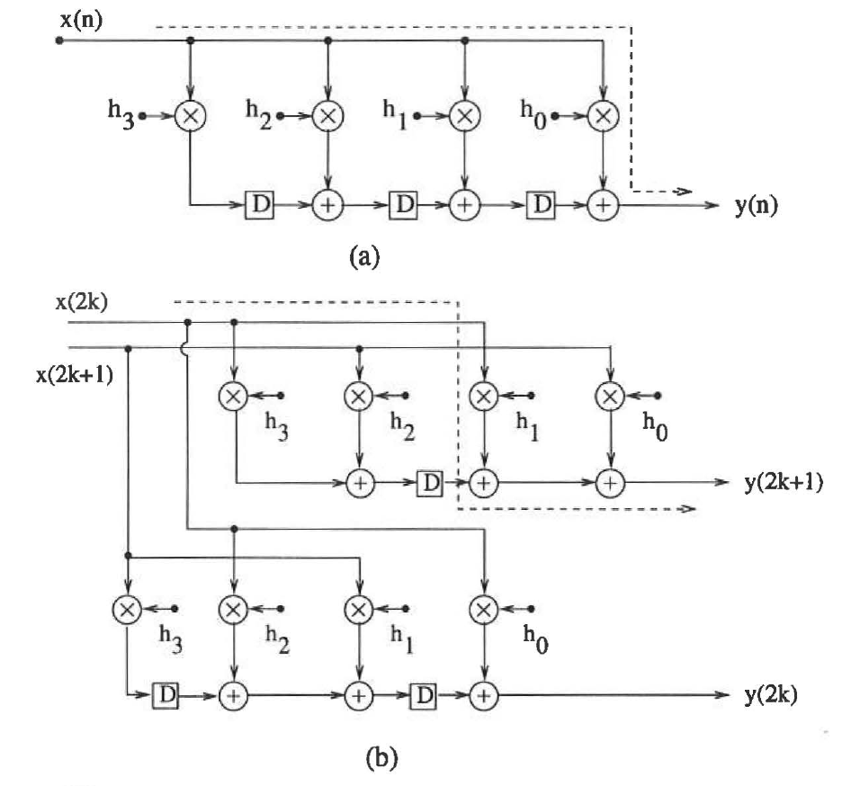
Pipelining and Parallel Processing for Low Power
A 4-tap FIR filter
A 2-parallel filter

Slide 52
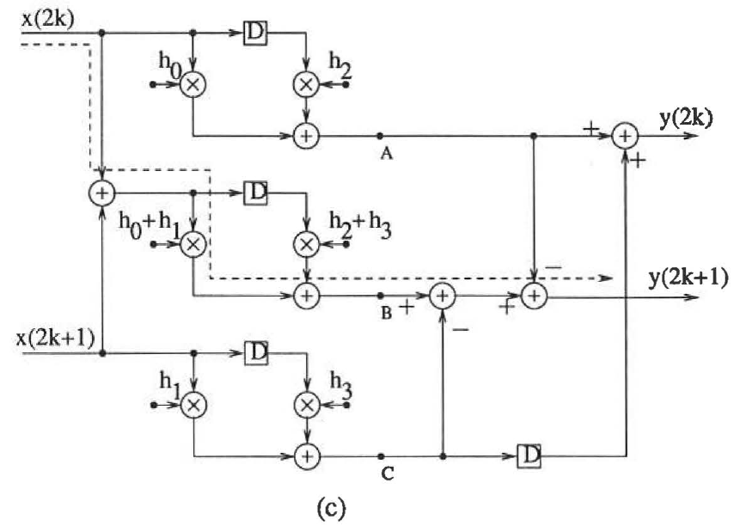
Pipelining and Parallel Processing for Low Power
An area-efficient 2-parallel filter

Slide 53

Pipelining and Parallel Processing for Low Power

Slide 54

Pipelining and Parallel Processing for Low Power

